Slide 1
19CS3113S
Analysis and Design of Algorithms
Session -22

Slide 2
The Travelling Salesperson Problem - Introduction
A traveler needs to visit all the cities from a list, where distances between all the cities are known and each city should be visited just once.
What is the shortest possible route that he visits each city exactly once and returns to the origin city?
Travelling salesman problem is the most notorious computational problem. We can use brute-force approach to evaluate every possible tour and select the best one. For n number of vertices in a graph, there are (n - 1)! number of possibilities.
Instead of brute-force using dynamic programming approach, the solution can be obtained in lesser time, though there is no polynomial time algorithm.

Slide 3
Problem Definition:
Let G (V, E) be a directed graph with edge cost c_{i, j} is defined such that c_{i, j} >0 for all i and j and c_{i, j} =∝ , if <i, j> ∉ E.
Let V = n and assume n>1.
The traveling salesman problem is to find a tour of minimum cost.
A tour of Graph G is a directed cycle that include every vertex in V.
The cost of the tour is the sum of cost of the edges on the tour.
The tour is the shortest path that starts and ends at the same vertex (i.e.) 1.

Slide 4
APPLICATION :
Suppose we have to route a postal van to pick up mail from the mail boxes located at ‘n’ different sites.
An n+1 vertex graph can be used to represent the situation.
One vertex represent the post office from which the postal van starts and return.
Edge <i,j> is assigned a cost equal to the distance from site ‘i’ to site ‘j’.
the route taken by the postal van is a tour and we are finding a tour of minimum length.

Slide 5
Dynamic Programming Approach
  every tour consists of an edge <1,k> for some k ∈ V-{} and a path from vertex k to vertex 1.
the path from vertex k to vertex 1 goes through each vertex in V-{1,k} exactly once.
the function which is used to find the path I
g(1,V-{1}) = min{ cij + g(j,s-{j})}
g(i,s) be the length of a shortest path starting at vertex i, going through all vertices in S, and terminating at vertex 1.

Slide 6
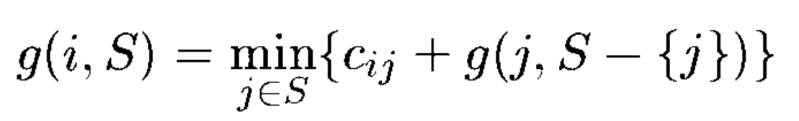
Dynamic Programming Approach
The function g(1,v-{1}) is the length of an optimal tour.
Generalizing (1) ,we obtain
Equation (1) can be solved for g(1, V-{1}) if we know g(k, V-{1,k})
for all choices of k.

Slide 7
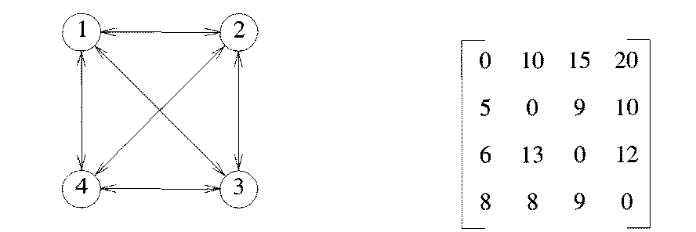
Example-Finding minimum cost tour for TSP
| s | = 0.
g(2,Φ) = c₂₁ => 5
g(3,Φ) = c₃₁ => 6
g(4,Φ) = c₄₁ => 8

Slide 8
|S | = 1
g(2,{3}) = c₂₃ + g(3,Φ) = 9+6 =15
g(2,{4}) = c₂₄ + g(4,Φ) = 10+8 =18
g(3,{2}) = c₃₂ + g(2,Φ) = 13+5 =18
g(3,{4}) = c₃₄ + g(4,Φ) = 12+8 =20
g(4,{2}) = c₄₂ + g(2,Φ) = 8+5 =13
g(4,{3}) = c₄₃ + g(3,Φ) = 9+6 =15

Slide 9
|S | = 2
g(2,{3, 4}) = min{ c₂₃ + g(3, {4}), c₂₄+ g(4, {3}) }
min{ 9+20, 10+15}
min{29, 25} = 25
g(3, {2, 4}) =min{c₃₂+ g(2, {4}), c₃₄ + g(4, {2})}
min{13+18, 12+13}
min{31,25} =25
g(4, {2, 3}) =min{c₄₂+ g(2, {3}), c₄₃+ g(3, {2})}
min{8+15, 9+18}
min{23, 27} =23

Slide 10
|S | = 3
g(1, {2, 3, 4}) = min{c₁₂+ g(2, {3, 4}),
c₁₃ + g(3, {2, 4}),
c₁₄ + g(4, {2, 3}) }
min{10+25, 15+25, 20+23}
min{35, 35, 43} =35
optimal cost is 35
the shortest path is,
g(1,{2, 3, 4}) = c₁₂ + g(2, {3, 4}) => 1 -> 2
g(2,{3, 4}) = c₂₄ + g(4,{3}) => 1->2->4
g(4,{3}) = c₄₃ + g(3,{Φ}) => 1->2->4->3->1
so the optimal tour is 1 → 2 → 4 →3 → 1

Slide 11
Analysis
An algorithm that proceeds to find an optimalt our by using(1)and (2) will require θ(n²2^{n}) time as the computation of g(i,S) with |S|= k requires k= 1 comparisons when solving (2).
This is better than enumerating all n! different tours to find the best one. The most serious drawback of this dynamic programming solution is the space needed, 0(n2^{n}).
This is too large even for modest values of n.

Slide 12
TRAVELLING SALESMAN PROBLEM
A
B
 | A | B | C | D
A | 0 | 16 | 11 | 6
B | 8 | 0 | 13 | 16
C | 4 | 7 | 0 | 9
D | 5 | 12 | 2 | 0
C
D
Distance between vertex
Graph represents the places to travel
A traveler needs to visit all the cities from a list, where distances between all the cities are known and each city should be visited just once. What is the shortest possible route that he visits each city exactly once and returns to the origin city?

Slide 13
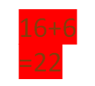
Travelling Distance Calculation
16+22
=38
A
 | A | B | C | D
A | 0 | 16 | 11 | 6
B | 8 | 0 | 13 | 16
C | 4 | 7 | 0 | 9
D | 5 | 12 | 2 | 0
B
C
D
13+14
=27
C
D
6
B
D
B
C
9+5
=14
D
C
D
B
C
B
5
4
A
A
A
A
A
A
g(i,S)=min[w(i,j)+g(j,{S-j})
i=starting vertex
S=set of vertex to travel
j Ɛ S

Slide 14
Minimum cost Finding from vertex A
g(i, ∅)=CiA
A
B
g(B, ∅)=cBA=8
g(C, ∅)=cCA=4
g(D, ∅)=cDA=5
C
D
 | A | B | C | D
A | 0 | 16 | 11 | 6
B | 8 | 0 | 13 | 16
C | 4 | 7 | 0 | 9
D | 5 | 12 | 2 | 0

Slide 15
Minimum cost Finding from vertex A
g(i,S)=min[w(i,j)+g(j,{S-j})
A
B
g(B,{C})=min[w(B,C)+g(C,{empty})]=13+4=17
g(C,{B})=min[w(C,B)+g(B,{empty})]=7+8=15
g(B,{D})=min[w(B,D)+g(D,{empty})]=16+5=21
g(D,{B})=min[w(D,B)+g(B,{empty})]=12+8=20
g(C,{D})=min[w(C,D)+g(D,{empty})]=9+5=14
g(D,{C})=min[w(D,C)+g(C,{empty})]=2+4=6
-------------------------------------------------------
C
D
 | A | B | C | D
A | 0 | 16 | 11 | 6
B | 8 | 0 | 13 | 16
C | 4 | 7 | 0 | 9
D | 5 | 12 | 2 | 0

Slide 16
Minimum cost Finding from vertex A
g(i,S)=min[w(i,j)+g(j,{S-j})
g(C,{B,D})=min[w(C,B)+g(B,{D})]=7+21=28
w(C,D)+g(D,{B})=9+20=29
g(D,{B,C})=min[w(D,B)+g(B,{C})]=12+17=29
w(D,C)+g(C,{B})=2+15=17
g(B,{C,D})=min[w(B,C)+g(C,{D})]=13+14=27
w(B,D)+g(D,{C})=16+6=22
------------------------------------------------------------
g(A,{B,C,D})=min[w(A,B)+g(B,{C,D}]=16+22=38
w(A,C)+g(C,{B,D}=11+28=39
w(A,D)+g(D,{B,C}=6+17=23
A
B
C
D
 | A | B | C | D
A | 0 | 16 | 11 | 6
B | 8 | 0 | 13 | 16
C | 4 | 7 | 0 | 9
D | 5 | 12 | 2 | 0

Slide 17
the shortest path is,
g(A,{B,C,D}) = cAC + g(C,{B,D}) => A->C
g(C,{B,D}) = cCB + g(B,{D}) => A->C->B
g(B,{D}) = cBD + g(D,{Φ}) => A->C->B->D->A
so the optimal tour is A → C → B →D → A

Slide 18
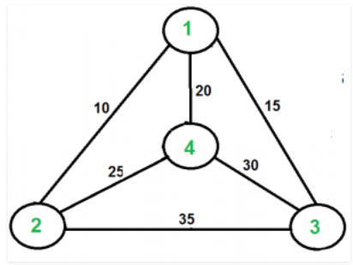
Find minimum cost tour for the following graph

Slide 19
Thank You

